Slide 1
CS2005 Database Systems
Fall 2021
National University of Computer and Emerging Sciences

Slide 2
CHAPTER 6
BASIC SQL

Slide 3
Basic SQL
SQL language
Considered one of the major reasons for the commercial success of relational databases
SQL
The origin of SQL is relational predicate calculus called tuple calculus (see Ch.8) which was proposed initially as the language SQUARE.
SQL Actually comes from the word “SEQUEL” which was the original term used in the paper: “SEQUEL TO SQUARE” by Chamberlin and Boyce. IBM could not copyright that term, so they abbreviated to SQL and copyrighted the term SQL.
Now popularly known as “Structured Query language”.
SQL is an informal or practical rendering of the relational data model with syntax

Slide 4
The CREATE TABLE Command in SQL
Specifying a new relation
Provide name of table
Specify attributes, their types and initial constraints
Can optionally specify schema:
CREATE TABLE COMPANY.EMPLOYEE ...
OR
CREATE TABLE EMPLOYEE ...

Slide 5
The CREATE TABLE Command in SQL (cont’d.)
Base tables (base relations)
Relation and its tuples are actually created and stored as a file by the DBMS
Virtual relations (views)
Created through the CREATE VIEW statement. Do not correspond to any physical file.
Attribute Data Types and Domains in SQL
The basic data types available for attributes include numeric, character string, bit string, Boolean, date, and time.

Slide 6
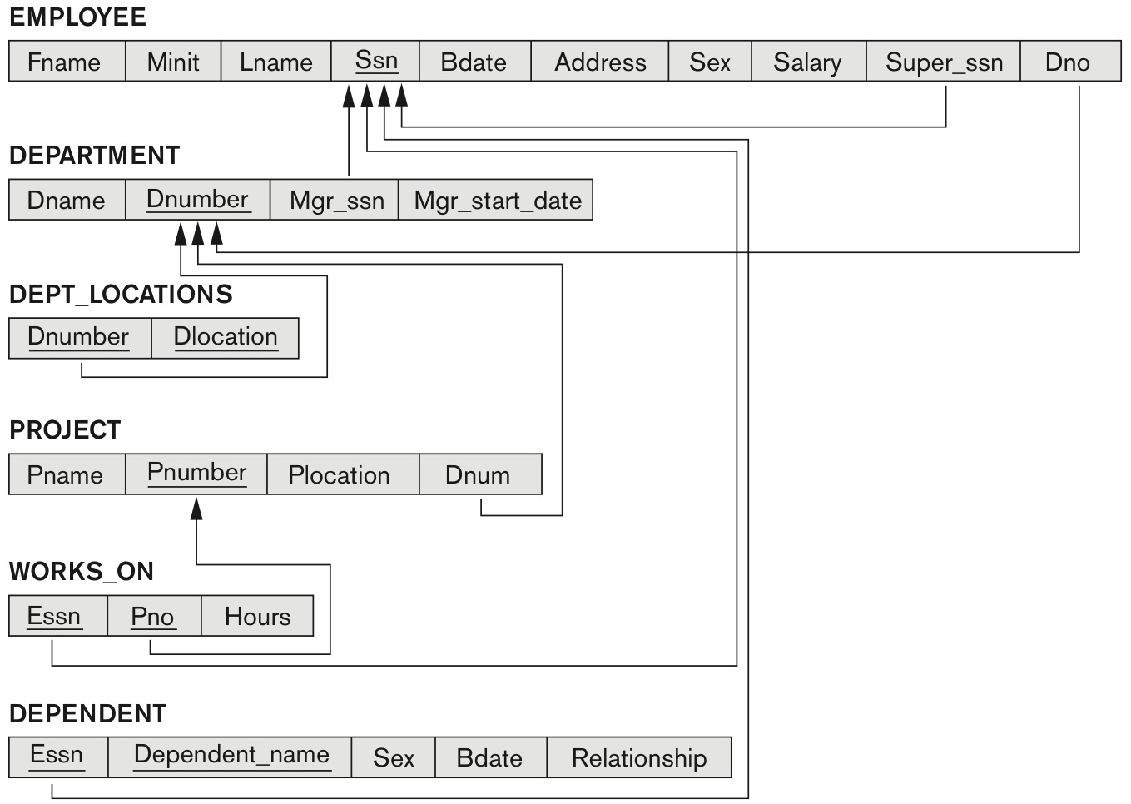
COMPANY relational database schema (Fig. 5.7)

Slide 7
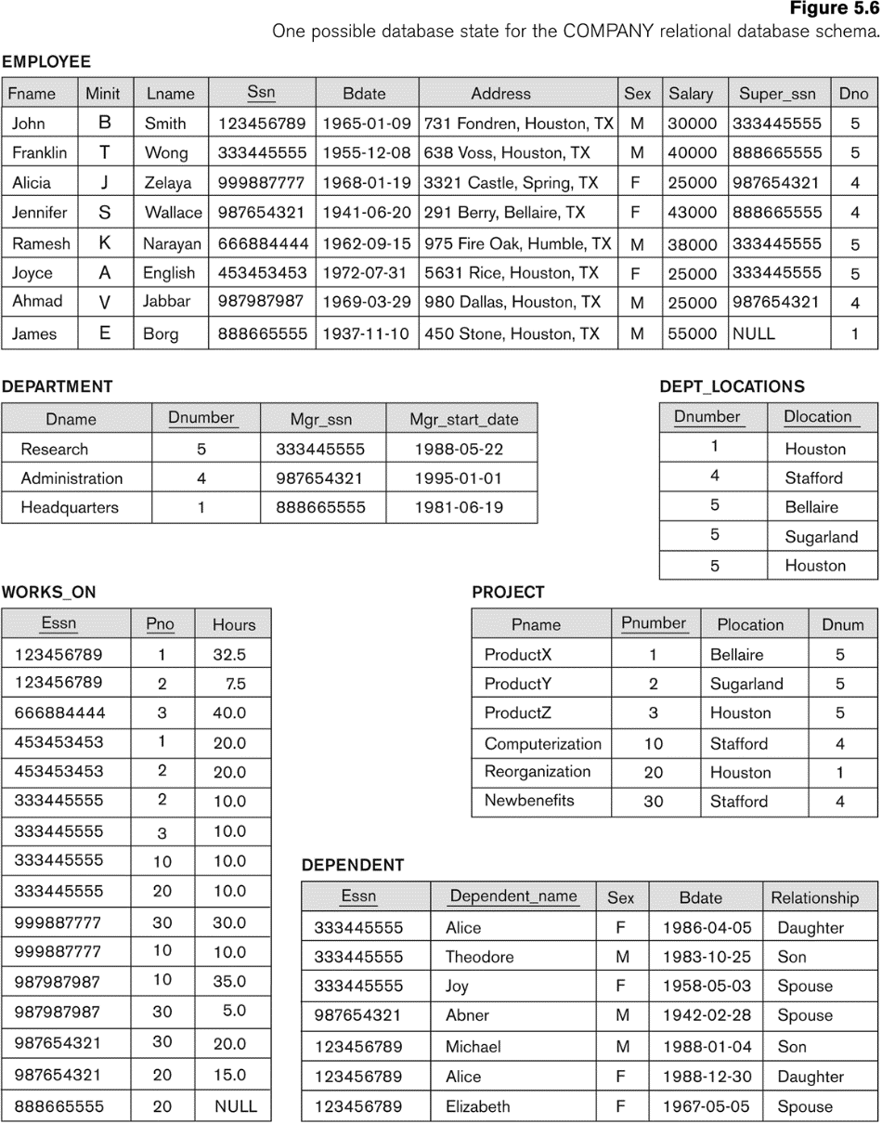

Slide 8
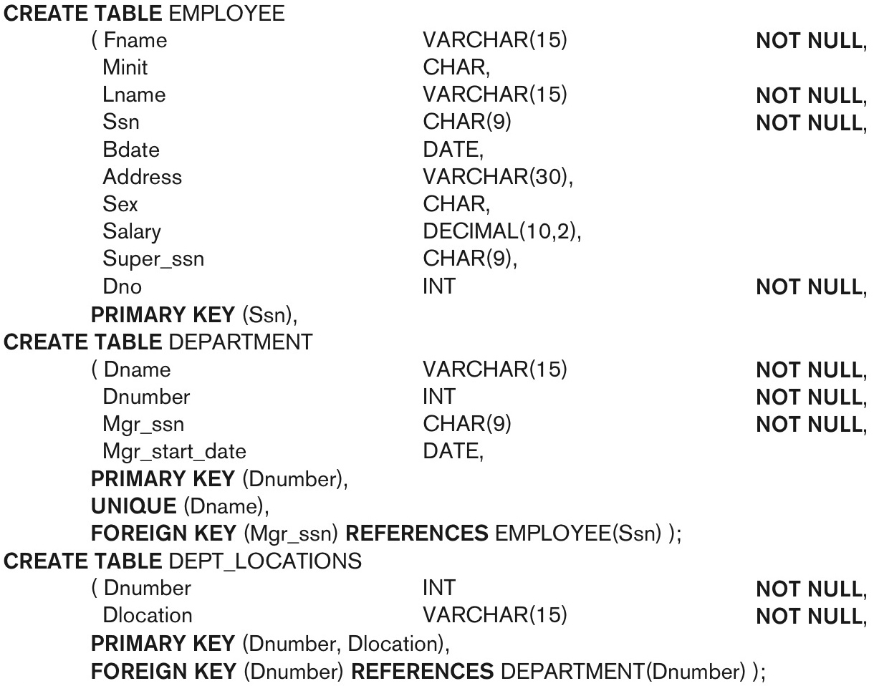
continued on next slide

Slide 9
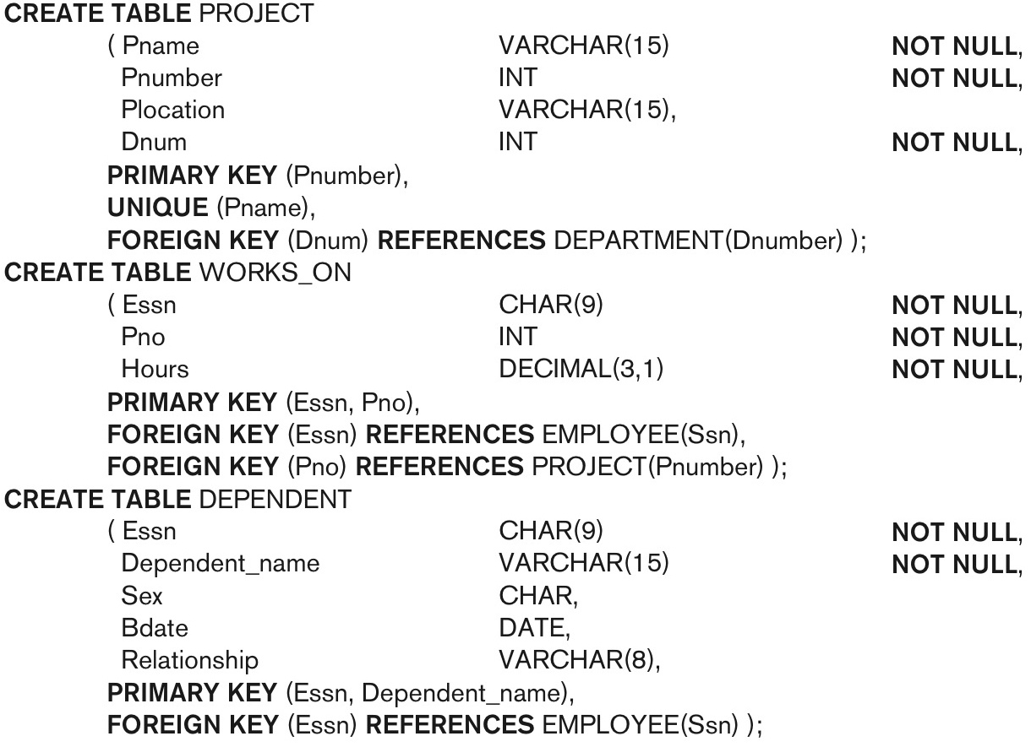
SQL CREATE TABLE data definition statements for defining the COMPANY schema from Figure 5.7 (Fig. 6.1)-continued

Slide 10
Specifying Constraints in SQL
Basic constraints:
Relational Model has 3 basic constraint types that are supported in SQL:
Key constraint: A primary key value cannot be duplicated
Entity Integrity Constraint: A primary key value cannot be null
Referential integrity constraints : The “foreign key “ must have a value that is already present as a primary key, or may be null.

Slide 11
Specifying Attribute Constraints and Attribute Defaults
A constraint NOT NULL may be specified if NULL is not permitted for a particular attribute.
This is always implicitly specified for the attributes that are part of the primary key of each relation, but it can be specified for any other attributes whose values are required not to be NULL
It is also possible to define a default value for an attribute by appending the clause DEFAULT <value> to an attribute definition.
The default value is included in any new tuple if an explicit value is not provided for that attribute

Slide 12
Specifying Attribute Constraints and Attribute Defaults
Another type of constraint can restrict attribute or domain values using the CHECK clause following an attribute or domain definition
Dnumber INT NOT NULL CHECK (Dnumber > 0 AND Dnumber < 21);

Slide 13
Specifying Key and Referential Integrity Constraints
PRIMARY KEY clause
Specifies one or more attributes that make up the primary key of a relation
Dnumber INT PRIMARY KEY;
UNIQUE clause
Specifies alternate (secondary) keys (called CANDIDATE keys in the relational model).
Dname VARCHAR(15) UNIQUE;

Slide 14
Specifying Key and Referential Integrity Constraints (cont’d.)
FOREIGN KEY clause
Default operation: reject update on violation
Attach referential triggered action clause
Options include SET NULL, CASCADE, and SET DEFAULT
Action taken by the DBMS for SET NULL or SET DEFAULT is the same for both ON DELETE and ON UPDATE
CASCADE option suitable for “relationship” relations

Slide 15
Giving Names to Constraints
Using the Keyword CONSTRAINT
Name a constraint
Useful for later altering

Slide 16
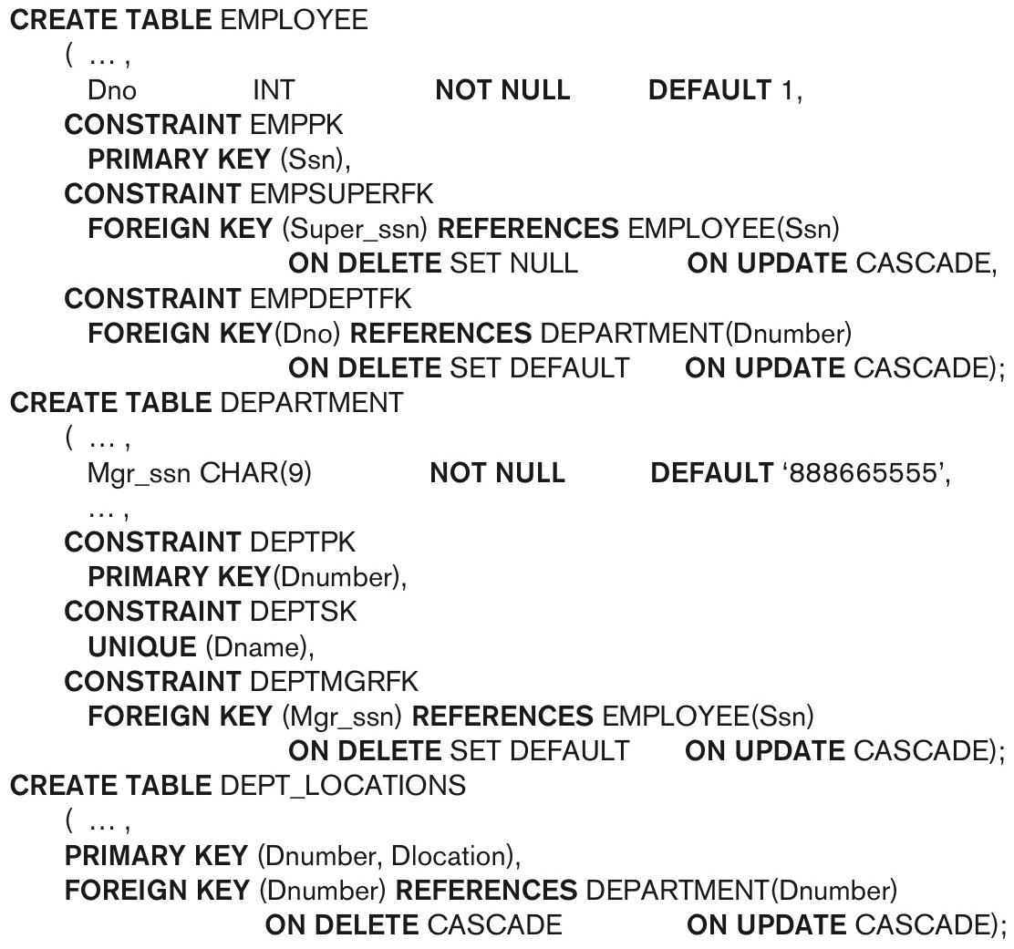
Default attribute values and referential integrity triggered action specification (Fig. 6.2)

Slide 17
Specifying Constraints on Tuples Using CHECK
Additional Constraints on individual tuples within a relation are also possible using CHECK
CHECK clauses at the end of a CREATE TABLE statement
Apply to each tuple individually
CHECK (Dept_create_date <= Mgr_start_date);

Slide 18
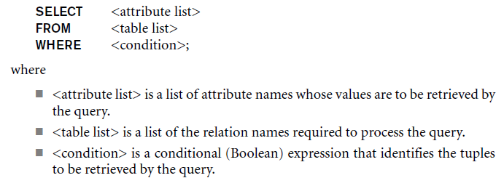
The SELECT-FROM-WHERE Structure of Basic SQL Queries
Basic form of the SELECT statement:

Slide 19
The SELECT-FROM-WHERE Structure of Basic SQL Queries (cont’d.)
Logical comparison operators
=, <, <=, >, >=, and <>
Projection attributes
Attributes whose values are to be retrieved
Selection condition
Boolean condition that must be true for any retrieved tuple. Selection conditions include join conditions (see Ch.8) when multiple relations are involved.

Slide 20
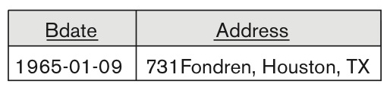
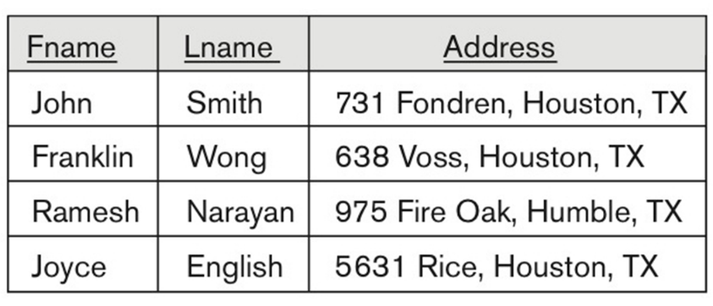
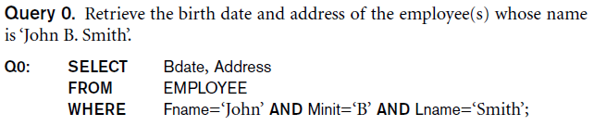
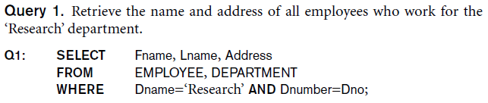
Basic Retrieval Queries

Slide 21
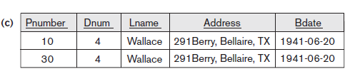
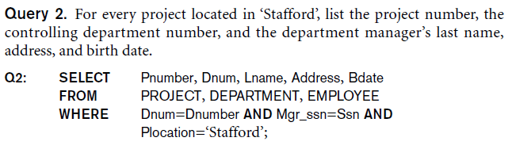
Basic Retrieval Queries (Contd.)

